Slide 1
9. Array Manipulation
Data Manipulation
Array Manipulation | reshape and resize | NumPy Tutorials
https://www.youtube.com/watch?v=KehyltXMrZE

Slide 2
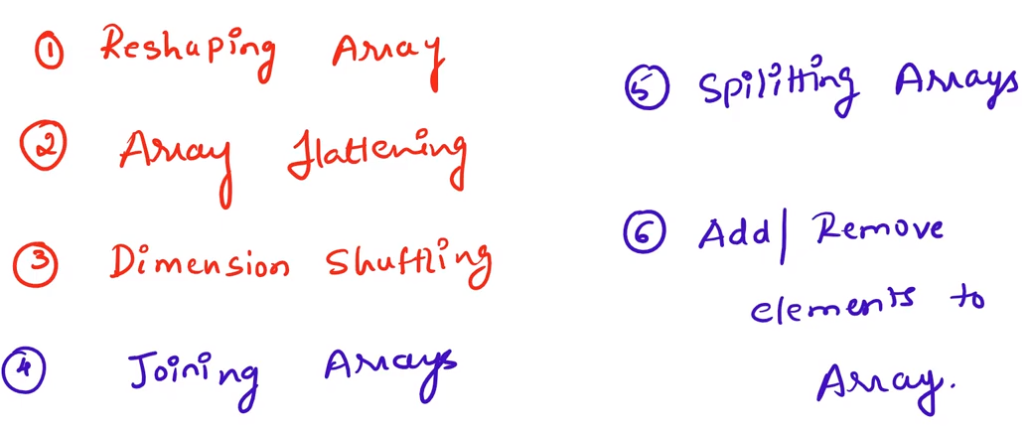

Slide 3
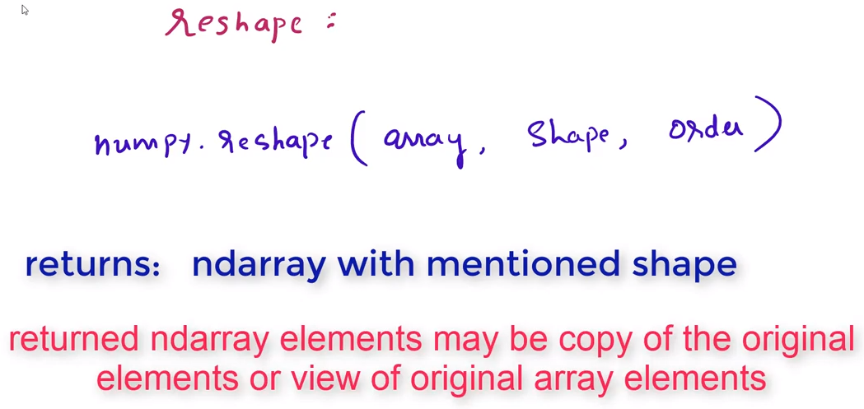
Reshape : Change the shape of given array without changing its size
resize : Change the shape as well as size of the array
Reshape :
np.reshape(array, shape, order)
“C”
“A”
“F”

Slide 4
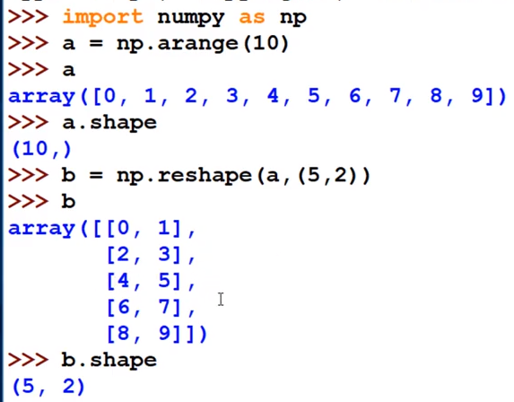
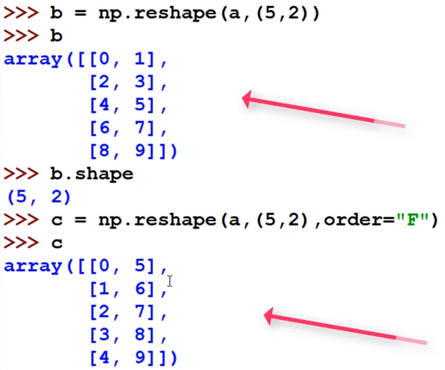
Row wise operation
Column wise operation

Slide 5
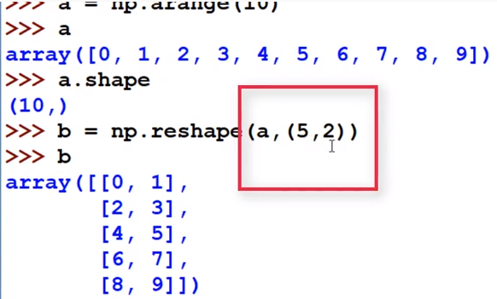
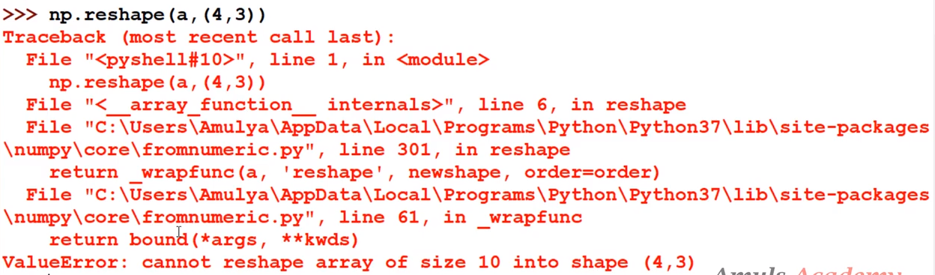
Array a having 10 elements
Reshape of Array a also should have 10 elements (5*2=10)
Here can't take 4*3=12 elements but a contains here only 10 elements

Slide 6
